Slide 1

one microtask
primes another
Edward Newell
Derek Ruths
Network Dynamics Group
McGill University

Slide 2
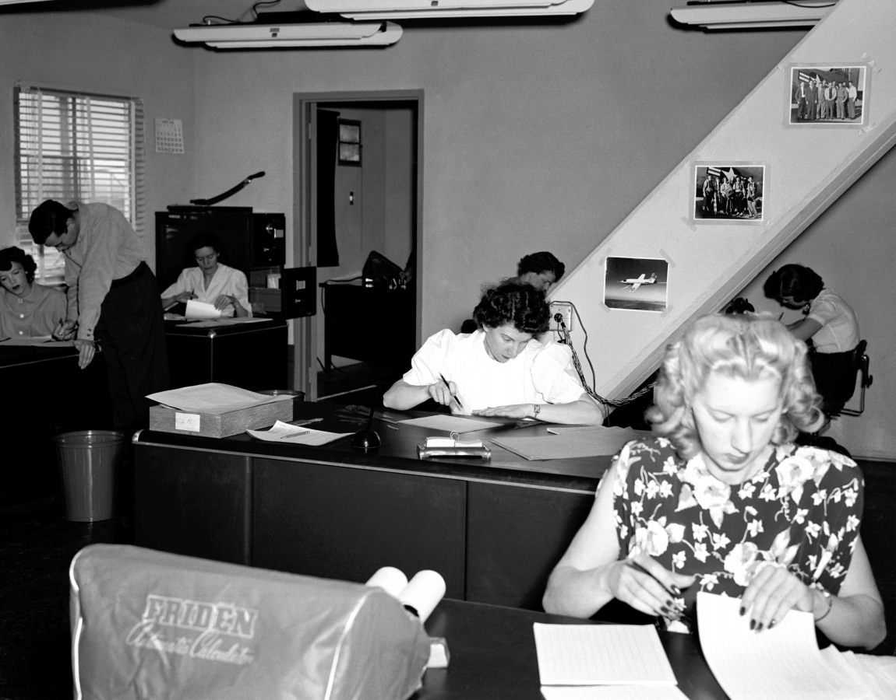

Slide 3

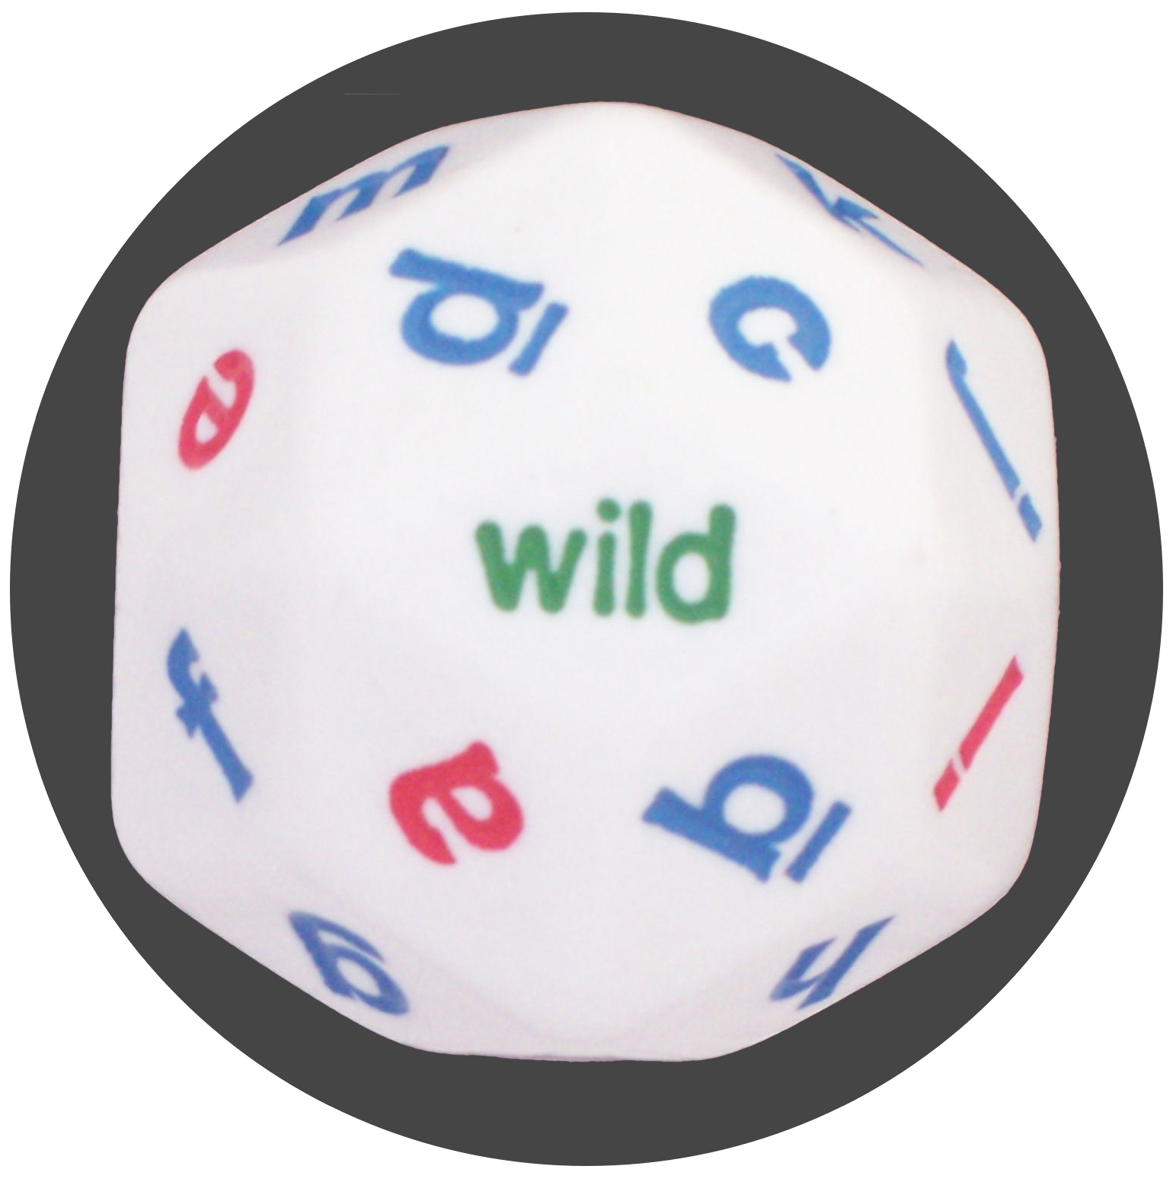
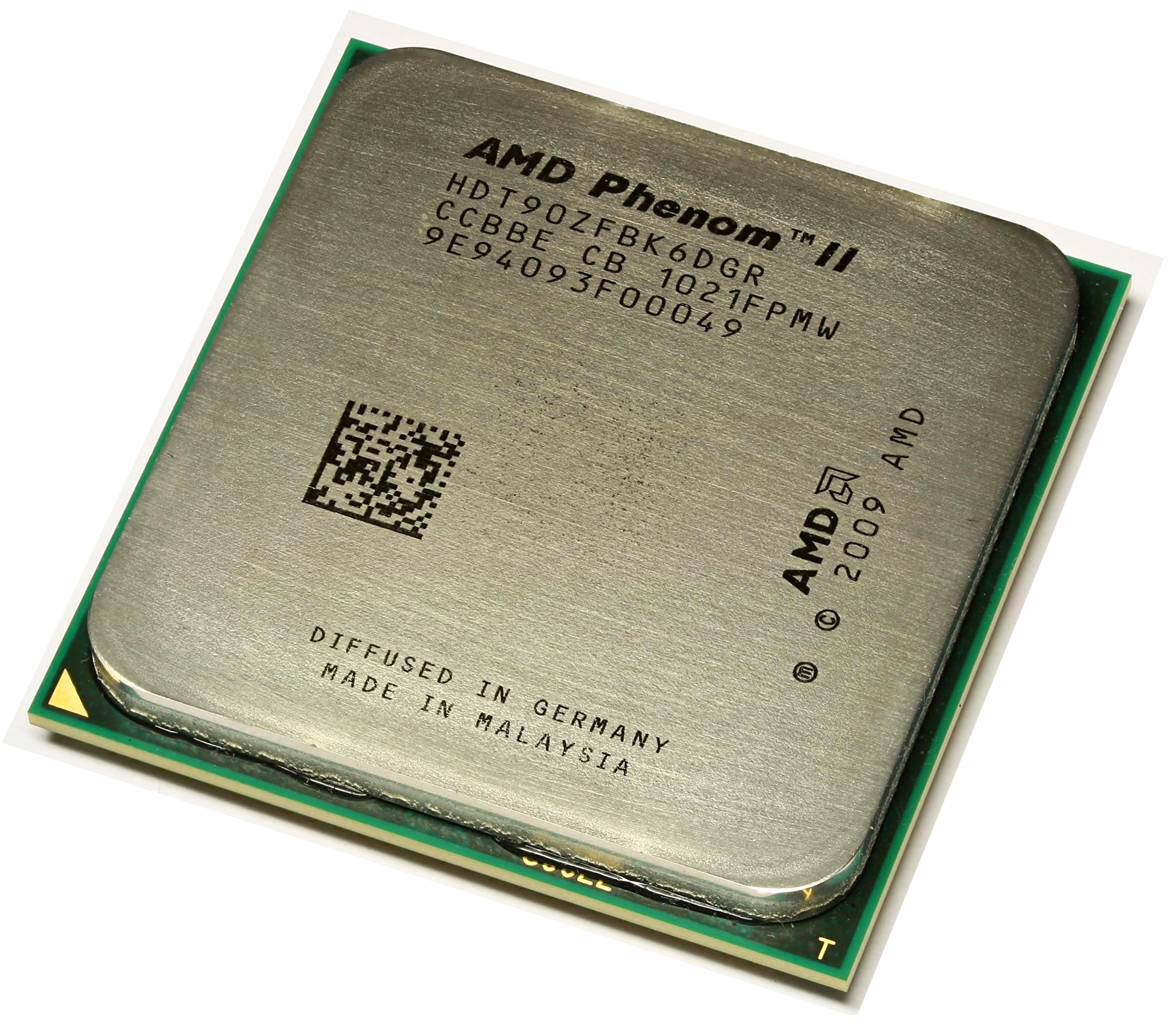
CPU
HPU
?

Slide 4


Slide 5
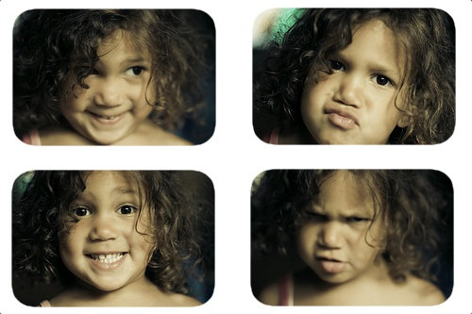

Slide 6
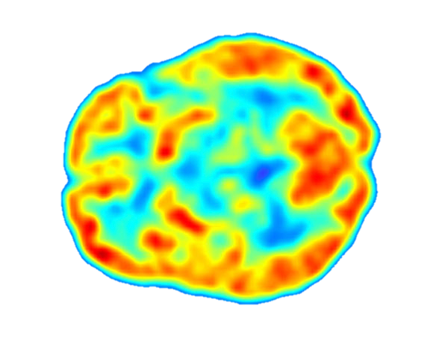

Slide 7
Variance
Stochastic
Systematic
Selection
Priming

Slide 8
Priming
?
?
Psychological
Computational

Slide 9
Priming can be strong
“Crime is a beast ravaging the city of Addison...”
“Crime is a virus ravaging the city of Addison...”
1. Rank the following solutions:
…

Slide 10
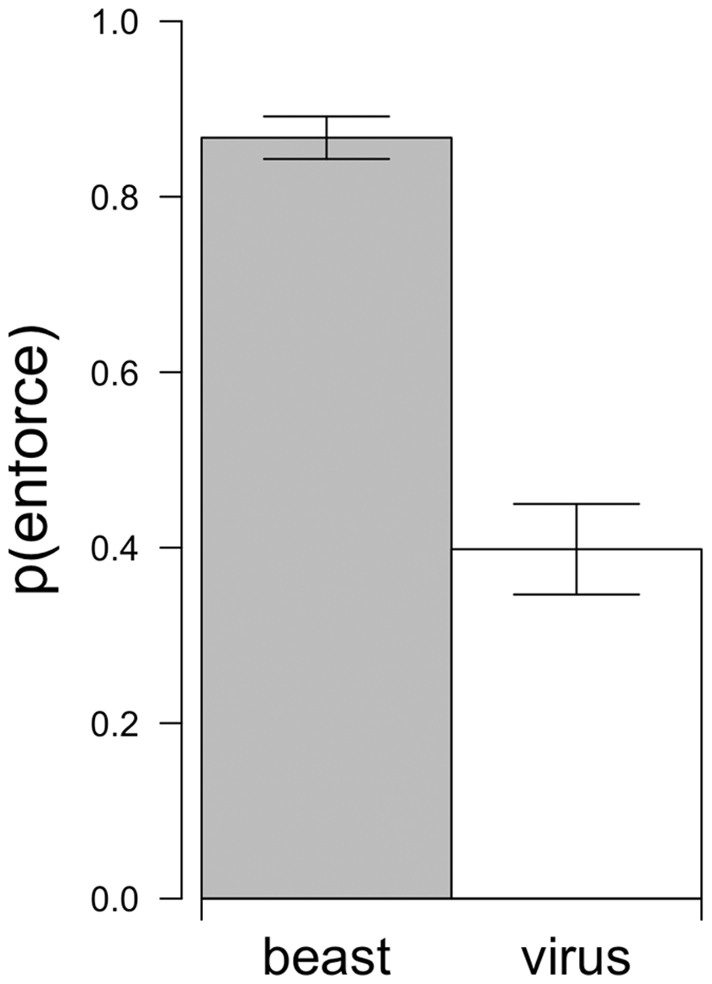
Priming can be strong

Slide 11
Can one task prime another?

Slide 12
How to measure priming?
R
prime
δ⁻
δ⁺
task
T
T
output
P
Q

Slide 13
How to measure priming?
D(P,Q)
Kulback-Liebler
Shannon-Jenson
L₁-distance

Slide 14
How to measure priming?
How should priming be measured?
hpu output
a binary decision

Slide 15
How to measure priming?
How should priming be measured?
if( ) {
…
} else {
…
}

Slide 16
How to measure priming?
How should priming be measured?
hpu output
a binary decision

Slide 17
How to measure priming?
How should priming be measured?
find the most susceptible decision
“max bias”

Slide 18
How to measure priming?
How should priming be measured?
max bias
L₁-distance
best classifier

Slide 19
How to measure priming?
How should priming be measured?
L₁-distance
clear interpretation: max bias
grounding in statistics and information theory
application-independant

Slide 20
Inter-task effects
T₁
T₂
prime?

Slide 21
Inter-task effects
food pics
inter-task
object pics
“ food ”
framing
“ objects ”

Slide 22


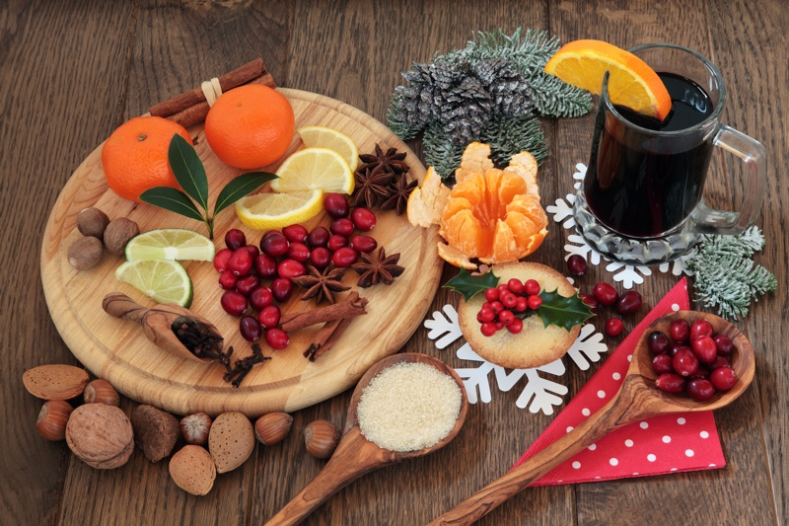
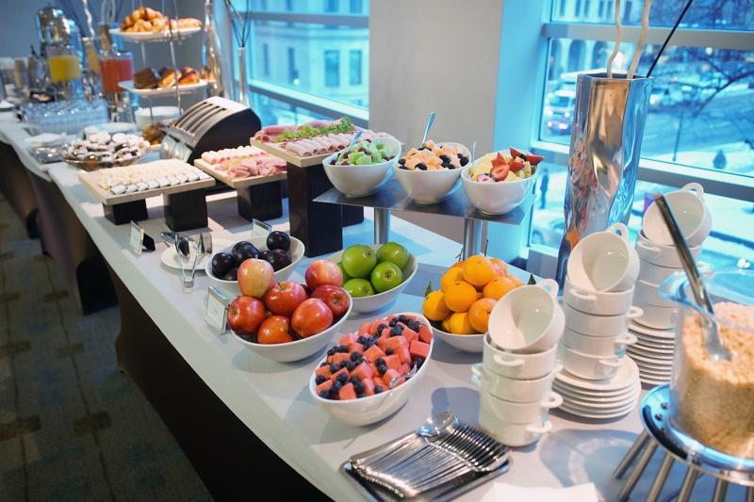

Test tasks

Slide 23
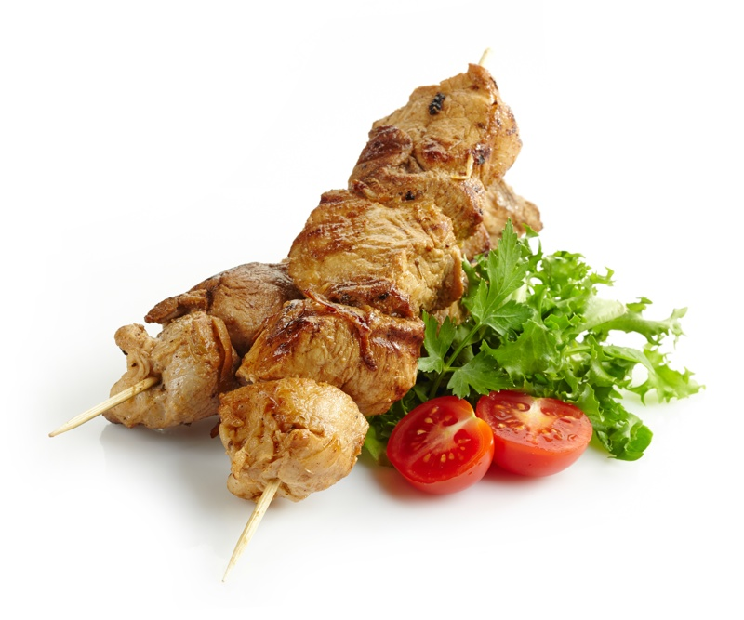
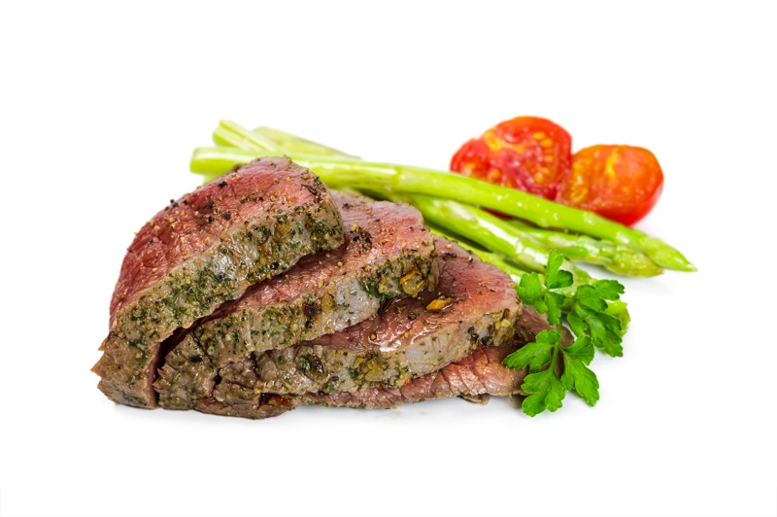
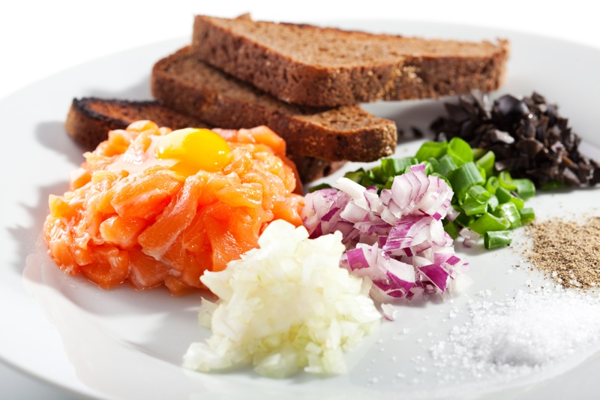
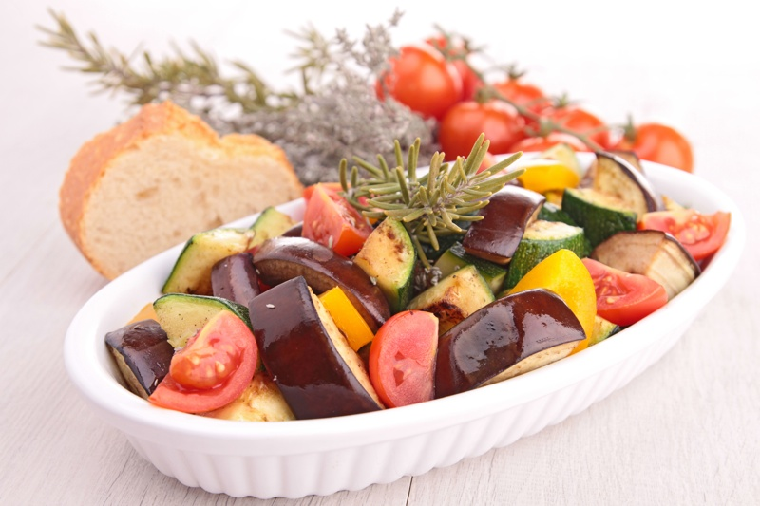
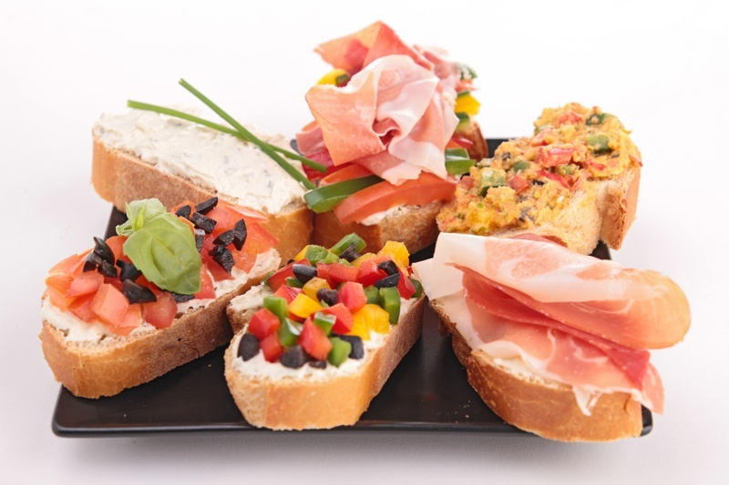
Initial tasks: food

Slide 24

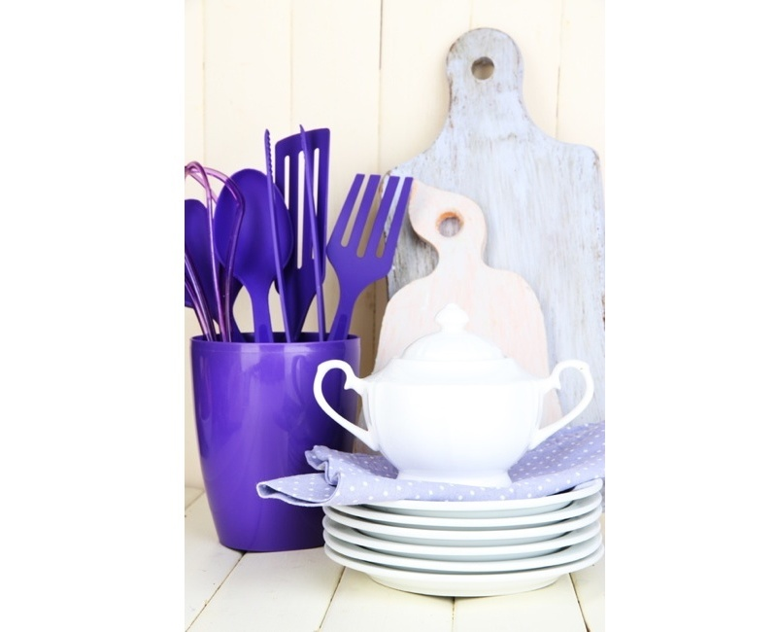



Initial tasks: objects

Slide 25
Framing
The purpose of this study is to understand the visual perception of
Food and Ingredients
The purpose of this study is to understand the visual perception of
Objects and Tools

Slide 26
Inter-task effects: stronger than framing

Slide 27
Inter-task effects: decay over time
spontaneous re-priming

Slide 28
Inter-task effects

Slide 29
Inter-task effects: direct focus

Slide 30
Measuring priming
classifier = difference detector
application-independant
interpretation: max bias
Inter-task effects
stronger than framing
significant 5 tasks later
spontaneous re-priming
alter specificity

